Slide 1
We are #1
Sprint Review Project Hope
Notes:
Put a nice graphic here

Slide 2
The Team
Rob O’Connor Artist
Tamara Hooijmans Artist
Humam Abud Allah Artist
Olivier de Haan Designer
Rick Oosthof Designer
Glyn Leine Engineer
Notes:
Put proper roles here

Slide 3
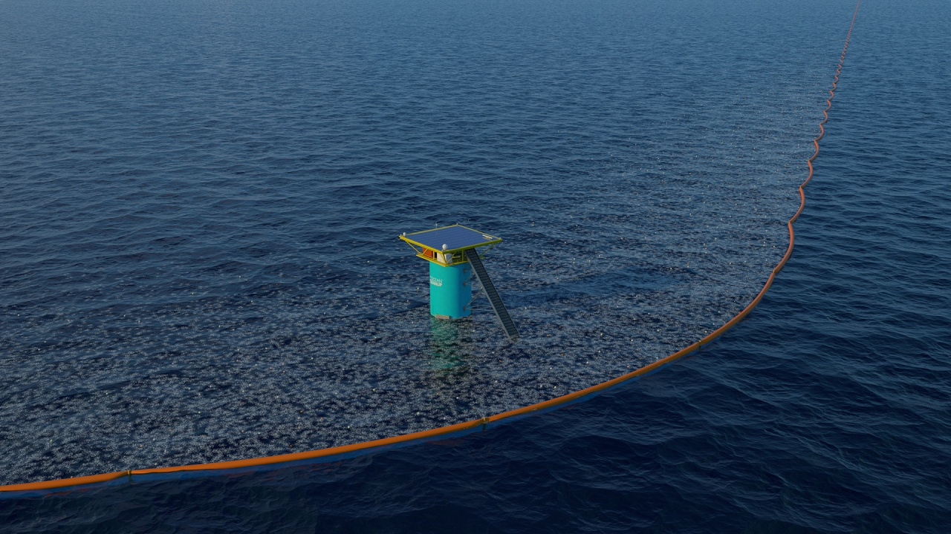

Notes:
This is where we briefly go over what the organization is

Slide 4
Research Section
Notes:
This is where I show the research we did into what to make and how we arrived at the conclusion of making a mobile game

Slide 5

Game Section
Notes:
This is where I go over what the game actually is

Slide 6
Mention about all the planning documents we have?(GDD/Asset lists/trello/git)
Make sure to explain theyre living breathing documents that will keep getting edited during the project they’d eat that shit up ya dig
Also a natural place to mention trello/github/sourcetree/discord/whatsapp but at the start after the team section is also OK
Notes:
Show how good we are at planning

Slide 7
UI Wireframe Section
Notes:
Short bit where I go over the process of making the wireframes

Slide 8
Moodboard Section
Notes:
Moodboard and possibly iterations?

Slide 9
Stylesheet Section
Notes:
Whats our style

Slide 10
Concept Art Section
Notes:
Many slides of concept art/our art style

Slide 11
Engineer Section
What did glyn do this week(doesn’t actually have to be presented by Glyn)
Notes:
Not the git document that’s earlier it’s the programming that’s the answer

Slide 12
Demo slide(gif/video?)
Notes:
Boat shoots trash

Slide 13
Next week
Notes:
Next week sprint backlog, what are we planning on doing next week?(nice quick fire list)

